Slide 1
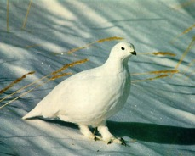
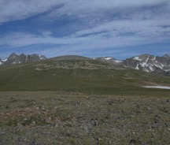
Pathways to Scientific Teaching Day 1 - AM Building a Learning Community 6 October 2017
Notes:
Need:
1 Constructive / Destructive Behaviors Handouts
2. Large postits
3. Small postits
4. Folders.

Slide 2
Working Schedule
Friday AM – 9 am-noon
Building a learning community
What is science practice-based instruction
Friday PM – 1 pm -4 pm
Building a transformed course framework
Designing one lesson
Saturday AM – 9 am-noon
Work in team on lesson
Report outs re: parts of lesson
Saturday PM – 1 pm- 4 pm
Revise and Teach an active learning segment of lesson

Slide 3
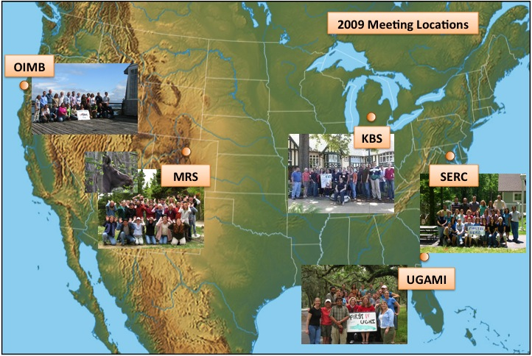
FIRST Postdocs/Faculty
201 at Field Stations
FIRST IV graph
Notes:
Two types of data were collected to assess the effectiveness of the traditional model of PD.
The first type was surveys which provided self-report data. Typically these are given to participants at the end of a workshop. Participants are asked about what they gained from the workshop, what was effective and what was not.
The second type of data was quantitative data obtained from external reviews of videotapes of the actual teaching of participants.
Complete sets of surveys and videotapes were obtained from 37 FIRST faculty and a similar number of SI faculty. These participants were the basis for evaluation of the PD model.

Slide 4
Thanks to special people
Undergrads
Greg Moyer-Brailean
Shauna Jones
Emily Nagler
Cody Bekkering
Rachael Nye Jaeger
Dan Totzkay
Josh Abati
Janet Batzli
Debra Linton
Tammy Long
Elena Bray Speth
Jessica Middlemis Maher
Jenni Momsen
Sara Wyse
Anne-Marie Hoskinson
Jonathan Markey
Jan Hodder
Terry Derting
DUE 0817224

Slide 5
Number of teaching workshops
Research Field
ZOE
Positive Attribute
Status – fac, pd, grad
Group Name
Chapter 1: Ebert-May and Hodder (2008) Pathways to Scientific Teaching
Notes:
You will be working in collaborative groups in this course. For today, form groups of 3-4 with people around you. Give your group a name – anything you want! You’ll have the opportunity to change groups next before next Tuesday, when we finalize the groups for the semester (of course, you can also keep your groups from today!). Each day, sit with your group members.
Folders – a tool. Each day, pick up your folder as you walk in and return it at the end of class. You’ll use your folder to hand in the in-class work each class and we’ll return class work, quizzes, exams, etc. to your folder. It also helps us learn your names – hang it over the edge of your desk – and a little bit about you. So, now – take a few minutes to fill in the info. All parts are done individually, except your group name on the tab.

Slide 6
Constructive
Destructive
Cooperating: Is interested in the views and perspectives of the other group members and is willing to adapt for the good of the group.
Clarifying: Makes issues clear for the group by listening, summarizing and focusing discussions.
Inspiring: Enlivens the group, encourages participation and progress.
Harmonizing: Encourages group cohesion and collaboration. For example, uses humor as a relief after a particularly difficult discussion.
Risk Taking: Is willing to risk possible personal loss or embarrassment for the group or project success.
Process Checking: Questions the group on process issues such as agenda, time frames, discussion topics, decision methods, use of information, etc.
Dominating: Takes much of meeting time expressing self views and opinions. Tries to take control by use of power, time, etc.
Rushing: Encourages the group to move on before task is complete. Gets "tired" of listening to others and working as a group.
Withdrawing: Removes self from discussions or decision-making. Refuses to participate.
Discounting: Disregards or minimizes group or individual ideas or suggestions. Severe discounting behavior includes insults, which are often in the form of jokes.
Digressing: Rambles, tells stories, and takes group away from primary purpose.
Blocking: Impedes group progress by obstructing all ideas and suggestions. "That will never work because…"
Obtained 4/6/09 from: https://tle.wisc.edu/solutions/engagement/constructive-and-destructive-group-behaviors. Adapted from Brunt (1993). Facilitation Skills for Quality Improvement. Quality Enhancement Strategies. 1008 Fish Hatchery Road. Madison WI 53715

Slide 7
Transparency with our students

Slide 8
Folder Filing System
Designer Genes
AARDVARK
CACTI

Slide 9
How does the “box” system work?
At the beginning of each class, one member of team picks up folders for group.
End of class, one person/group put folders back according to group name or number.
In-class work: put in “In-class box”
Homework: in HW box before class
Chapter 1: Ebert-May and Hodder (2008) Pathways to Scientific Teaching

Slide 10
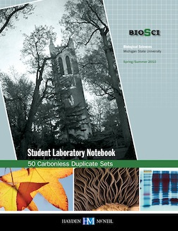
Carbonless Notebook
Hayden McNeil
Grand Rapids, MI

Slide 12
Form Teams and Group Contract
Form teams - groups of 4
Give your team a name
Contact information – on CATME
Decide on how you will communicate
2. Each group completes 1 Team Contract.
3. DUE – next week….Give students the date

Slide 13
Group Contract – D2L
Your Team Name: _________________________________________________________
1. What are your team’s goals? In the context of this semester and in this class, what do you hope to accomplish as group? Goals can be specific to learning and/or group dynamics. List at least 3 that you share in common.
2. Ground Rules. We have provided the first 2 for you, but your group should adopt additional ground rules you believe are necessary to help ensure everyone fully understands their responsibilities to and expectations of one another.
Prepare for class and team meetings by completing required assignments, arriving on time, and participating fully in team activities.
Respect the contributions and personal opinions of team members and classmates by conducting yourself in a professional manner in class and out-of-class team meetings.
Additional ground rules unique to your group. What additional ground rules will your group adopt to increase the likelihood your group’s success?
3. Communication. In a few sentences, explain how your group will maintain communication in a way that ensures all members are fully informed. Be sure to exchange appropriate contact information.
4. Consequences of failure to comply: If one or more members of the team repeatedly fails to meet the group’s agreed-upon ground rules, other members of the group will take the following actions:
Step 1: (fill in this step with your group. What will be your team’s first course of action to resolve the conflict?)
Step 2: If not resolved, one or more members bring this issue to the attention of the instructor.
Step 3: If not resolved, all members of the team will meet together with the instructor.
The instructor reserves the right to make a final decision to resolve difficulties that arise within groups. Before this becomes necessary, the team should try to find a fair and equitable solution to the problem.
Group Members Signatures: Date: ______________________
_______________________________________ ________________________________________
_______________________________________ __________________________________________

Slide 14
Q1. Why use groups in a course?
Think-Pair-Share (TPS)
Support group
Collective wisdom
Efficient – reduces the 200 person to 50 groups – seems more manageable to work with. Can have some group projects/quizzes/exams.

Slide 15
https://www.aacu.org/leap/principles-of-excellence

Slide 16
Go Meta
During the last few minutes, what did we do and why?
Think – Pair – Share (T-P-S)

Slide 17
Outcomes from Seminar
A pathways to scientific teaching lesson!!
Ready for implementation

Slide 19
Questions for you….on postits
What are your successes and challenges with teaching and learning…
with Students
with Peers (e.g., in your department)
with Your PI (or grad students/postdocs)
Write successes and challenges – one per postit.
Put under appropriate column on wall postit

Slide 20
Objectives 10-6-17
Characterize and develop a learning community
Investigate how people learn.
Determine the relationship of core biology concepts and scientific practices.
Design two learning objectives based on and activity.

Slide 21
Homework for this Afternoon
AM
How People Learn (HPL) - Chpts 1&2
Scientific Teaching – Handelsman et al
PM
Vision and Change Chpts 1 & 2
Start looking for a scientific paper that illustrates the “big ideas” in V&C. Bring possible examples to class next week.

Slide 22
National Research Council. 2000. How people learn: brain, mind, experience, and school. Washington, D.C.: National Academy Press.
Notes:
Diversity -- ideas, background, knowledge, personalities, culture -- makes each student unique (Handelsman et al 2007)…Therefore, every teaching situation is unique -- every student is unique…Sooo when we ask research questions about students in a classroom….we are dealing with a very complex system.

Slide 23
Brewer C, Smith D. 2009. Vision and change in undergraduate biology education: A call to action. Washington, D.C.: American Association for the Advancement of Science
Notes:
V and C concepts - evolution, pathways and transformations of energy and matter, information flow, exchange and storage, structure and function, and systems
We say we want students to develop systems thinking…building connections – can demonstrate in carbon cycle.
Search for interrelationships within a problem – attitude of mind facing complexity.
Students focus on the components of a system.
Have trouble identifying and building relationships
Have trouble building complexity – e.g., moving across scales, incorporating feedback loops
Have limited understanding of the function of a system.

Slide 24
Core Concepts for Biological Literacy
1. EVOLUTION: The diversity of life evolved over
time by processes of mutation, selection, and
genetic change.
2. STRUCTURE AND FUNCTION: Basic units of structure define the function of all living things.
3. INFORMATION FLOW, EXCHANGE, AND STORAGE: The growth and behavior of organisms are activated through the expression of genetic information in context.
4. PATHWAYS AND TRANSFORMATIONS OF ENERGY AND MATTER: Biological systems grow and change by processes based upon chemical transformation pathways and are governed by the laws of thermodynamics.
5. SYSTEMS: Living systems are interconnected and interacting.
C. Brewer, PERG, 2/2011
Notes:
24

Slide 25
Why transform?
Student feedback

Slide 26
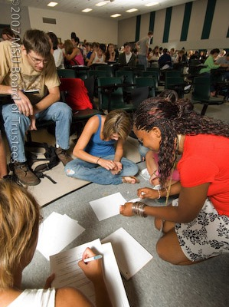
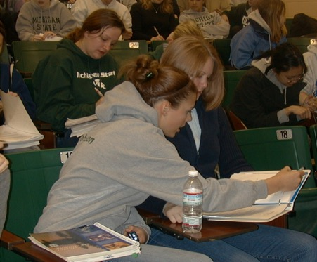

Slide 27
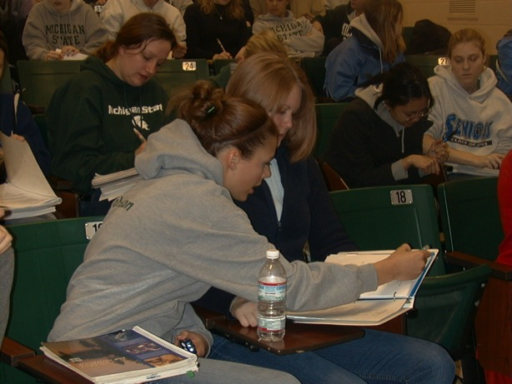
What do you see? What would you hear?

Slide 28
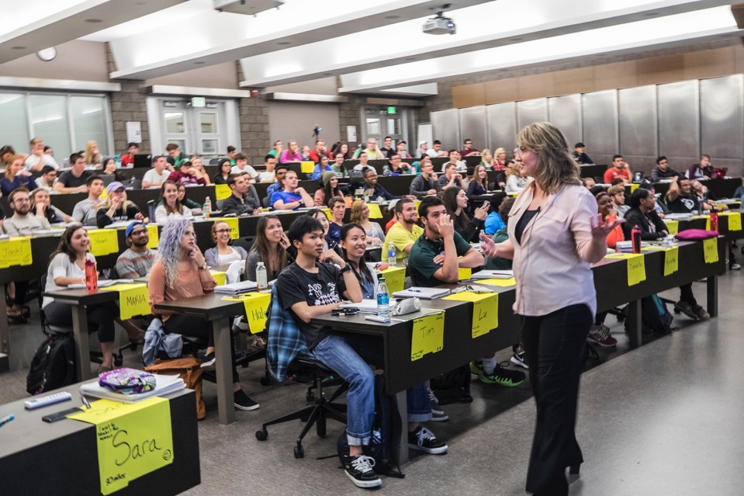
Note: Smiling faces……

Slide 29
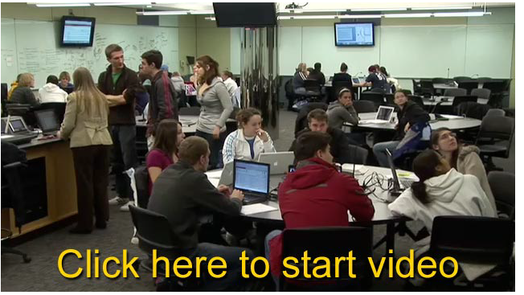
Who is the teacher?
Scale-up Classroom University of Minnesota
College of Biological Sciences -- Robin Wright

Slide 30
Postit #1
Active learning strategies enable all students to learn science better than information-transfer lectures.
A = strongly agree
B = agree
C = neutral
D = disagree
E = strongly disagree

Slide 31
Postit #2
Students learn science best by “doing” science.
A = strongly agree
B = agree
C = neutral
D = disagree
E = strongly disagree

Slide 32
Postit #3
How important is it to use multiple kinds of assessments to determine students’ learning?
A = very important
B = important
C = somewhat important
D = not very important
E = not important at all

Slide 33
Diversity affects learning
Notes:
Diversity -- ideas, background, knowledge, personalities, culture -- makes each student unique (Handelsman et al 2007)…Therefore, every teaching situation is unique -- every student is unique…Sooo when we ask research questions about students in a classroom….we are dealing with a very complex system.

Slide 34
Discuss in Groups – Select a reporter
How People Learn (HPL): Chpt 1:
Go to: Key Findings section: begins on p.14
Students’ preconceptions
Competence in an area of inquiry
3. Metacognitive approach
For each key finding:
a. What are the implications for teaching?
b. How do we design appropriate classroom environments?

Slide 35
How do people learn?

Slide 36
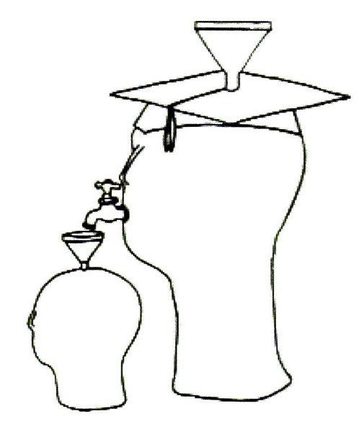
Smith et al 2005
Notes:
Transmission model

Slide 37
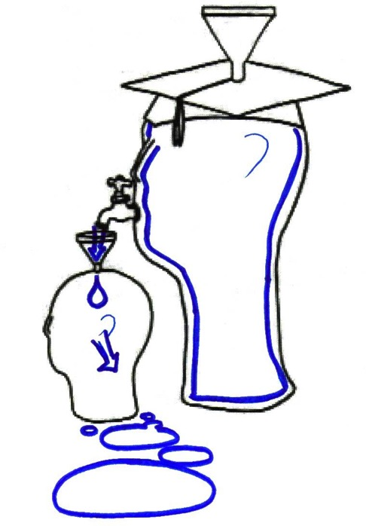

Slide 38
Teacher- to Learner-Centered Classroom
Q1. How does “scientific teaching” (as per Handelsman et al 2004) promote this transition?
Think –Pair -Share

Slide 39
Scientific Teaching
Teach science as it is practiced using evidence-based approaches
Handelsman et al 2004

Slide 40
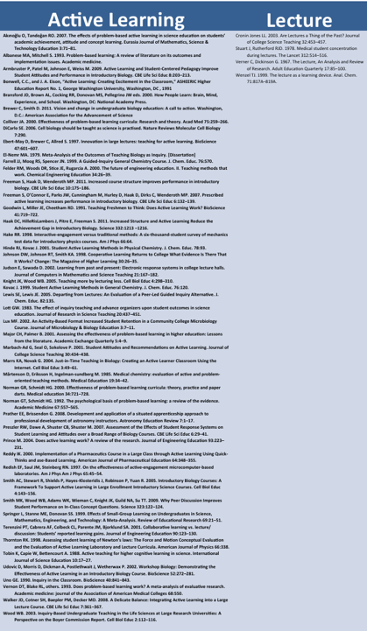
Research supports..

Slide 41
Q2. How do scientists create and communicate knowledge?

Slide 42
Q2. How do scientists create and communicate knowledge?
Design and carry out experiments. Observe.
Collaborate.
Read/study.
Explain data and ideas.
Represent systems through models.
Present arguments for the validity of their studies.

Slide 43
“Teach science as science is practiced at its best”
Educate our students so they can contribute effectively to society.
AAAS 1990

Slide 44
National Feedback: Literature
1986
1989
1990
1990
1996
Conclusions:
Biology has changed.
“Traditional” instruction is not preparing students for contemporary biology.
2000
2003
2007
2008
2008
2009
2011
2011
2012
2012

Slide 45
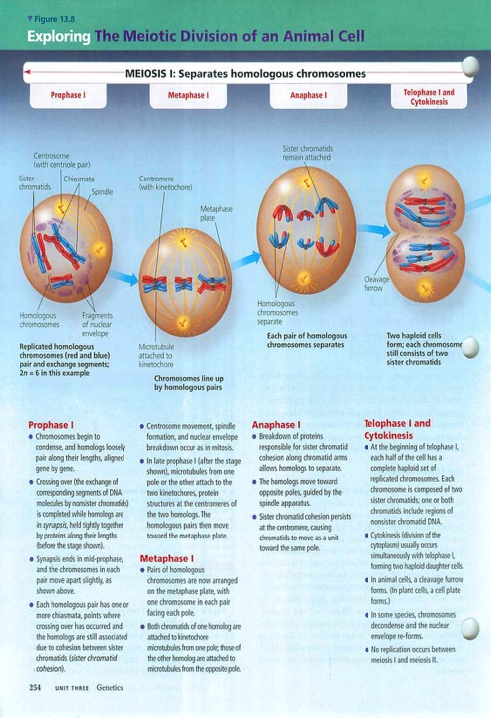
Compartmentalization Linearity

Slide 46
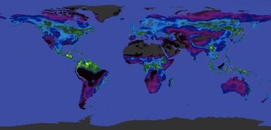
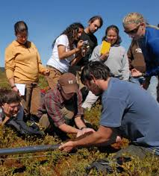
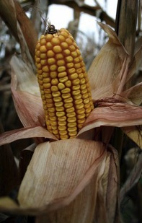
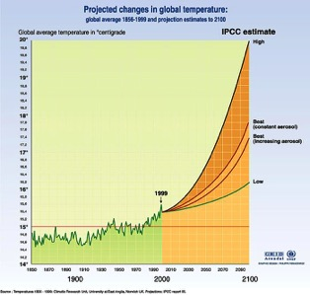
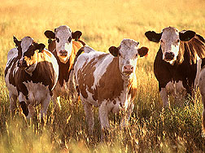
Notes:
The learning we want for them is fundamentally more complex. We want them to see relationships, big ideas, and foundational principles.
Focus is on connections among concepts and processes that occur over multiple scales of space and time.

Slide 47
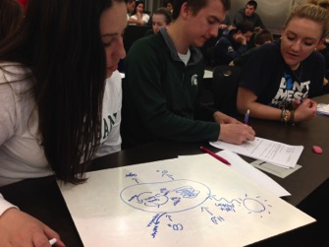
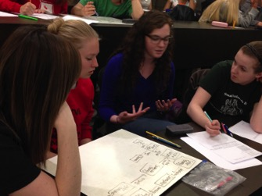
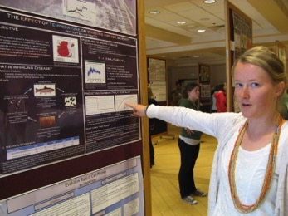
Integrating Concepts & Scientific Practices
Notes:
We are also beginning to accumulate some evidence about the importance of scientific practices on learning, and this complements some of the work that Sue Ellen is doing about how to teach these practices and what the effects of practices are on student learning.

Slide 48
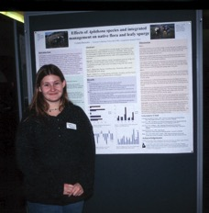
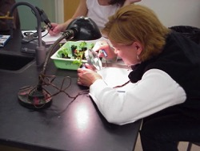
Core Competencies and
Disciplinary Practice
1. ABILITY TO APPLY THE PROCESS OF SCIENCE: Biology is evidence based and grounded in the formal practices of observation, experimentation, and hypothesis testing.
2. ABILITY TO USE QUANTITATIVE REASONING: Biology relies on applications of quantitative analysis and mathematical reasoning.
3. ABILITY TO USE MODELING AND SIMULATION: Biology focuses on the study of complex systems.
4. ABILITY TO TAP INTO THE INTERDISCIPLINARY NATURE OF SCIENCE: Biology is an interdisciplinary science.
5. ABILITY TO COMMUNICATE AND COLLABORATE WITH OTHER DISCIPLINES: Biology is a collaborative scientific discipline.
6. ABILITY TO UNDERSTAND THE RELATIONSHIP BETWEEN SCIENCE AND SOCIETY: Biology is conducted in a societal context.
C. Brewer, PERG, 2/2011
Notes:
48

Slide 49
Practice-based Science
Models
build, use, revise
Explanation
Reason, describe, evaluate
Arguments
claim, evidence, warrants (reason)
Collaboration
Data
collect, represent, analyze
Long, T. 2015. PLB Michigan State University

Slide 50
Core Concepts for Biological Literacy
1. EVOLUTION: The diversity of life evolved over
time by processes of mutation, selection, and
genetic change.
2. STRUCTURE AND FUNCTION: Basic units of structure define the function of all living things.
3. INFORMATION FLOW, EXCHANGE, AND STORAGE: The growth and behavior of organisms are activated through the expression of genetic information in context.
4. PATHWAYS AND TRANSFORMATIONS OF ENERGY AND MATTER: Biological systems grow and change by processes based upon chemical transformation pathways and are governed by the laws of thermodynamics.
5. SYSTEMS: Living systems are interconnected and interacting.
C. Brewer, PERG, 2/2011
Notes:
50

Slide 51
Materials for this Afternoon
Reading:
Tanner, K. 2010. Order Matters: Using the 5E model to align teaching with how people learn.
Each team: Bring in 3-4 papers to choose for lesson.
Bring in ”lecture” – ppt deck.

Slide 52
Team Formation

Slide 53
Practice-based Biology
Models
build, use, revise
Explanations
Describe, interpret, evaluate
Arguments
claim, evidence, warrant (reason)
Collaboration
Data
collect, represent, analyze
Long, T. 2015. PLB Michigan State University

Slide 54
On whiteboards
Data

Slide 55
Group project: Part 1
Observe the anatomical features of the plant cuttings. Select two traits that may be related.
Decide on the traits – and predict the relationship between the traits.
Propose a hypothesis that explains that relationship. Record.
Design a method to collect the data, (summarize as text) – then collect.
What is the sample size and justify.
Record your raw data in a notebook or whiteboard.

Slide 56
Group project: Part 2
Analyze and represent your data – On WHITEBOARDS
Write a figure legend for whatever representation you use.
What are the conclusions?
Did any assumptions influence the data or conclusions?
What were constraints and limitations of your method?

Slide 57
Develop two learning objectives for this exercise. Students will be able to….. Know and Do What?
Each Team

Slide 58
Pathways to Scientific Teaching Class Meeting PM What is model-based instruction? 6 October 2017
Notes:
Need:
1 Constructive / Destructive Behaviors Handouts
2. Large postits
3. Small postits
4. Folders.

Slide 59
Objectives 10-6 PM
Develop measurable learning objectives and assessments.
Identify and analyze students’ conceptions about core concepts.
Identify core ideas and practices in selecting a biology paper (form research teams).

Slide 60
Postit #4
In an intro STEM course (lower division), what percent of the students’ final grade is based on exams and quizzes?
A = 0 – 20%
B = 21 – 40%
C = 41 – 60%
D = 61 – 80%
E = 81 – 100%

Slide 61
Postit #5
The proportion of assessments used in an introductory biology course that demonstrate students’ problem solving and critical thinking abilities should be....
A = 0 – 20%
B = 21 – 40%
C = 41 – 60%
D = 61 – 80%
E = 81 – 100%

Slide 62
What are we doing in the classroom?
Lectures and multiple choice assessments prevail in university classrooms (US Dept of Education 2000, Wycoff 2001, NRC 2003, Seymour et al. 2006, Alberts 2009, Freeman et al 2014).
Claim: Introductory biology overemphasizes facts and rote memorization.
Evidence?
What level of cognition do faculty target in introductory biology?
What practices of science do students use to learn science?
Notes:
So what are we doing in the field – that is, in the classroom? Are we meeting the national challenges, incorporating institutional learning goals? It seems that we’re not yet hitting the mark – lectures and…. And
Research shows that lectures and MC dominate in our classrooms. This leads to the claim that introductory biology overemphasizes facts and rote memorization. But what’s the evidence?
So we asked the question – what level of knowledge are we targeting in intro biology courses? Are we overemphasizing facts and rote memorization?

Slide 63
Cognitive Level of Exam Items & Goals
n=9713
Momsen JL, Long TM, Wyse SA, Ebert-May D. 2010. Just the Facts? Introductory Undergraduate Biology Courses Focus on Low-Level Cognitive Skills. CBE Life Sci Educ 9:435–440.

Slide 64
“to educate and improve student performance, not merely to audit it”
Claim 1: Assessment is important
Wiggins G. 1998. Educative assessment: Designing assessments to inform and improve student performance. San Francisco, CA: Jossey-Bass
Claim 2: “If you don’t assess what’s important, what’s assessed becomes important”
Lauren Resnick, Institute for Learning, U of Pittsburgh

Slide 65
Students’ knowledge is often fragmented and incoherent.
Claim 3

Slide 66
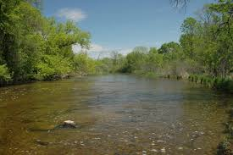
Claim 4: Traditional Introductory Biology Curriculum
Mile Wide
Inch Deep
Notes:
Find new picture

Slide 67
Bloom’s Taxonomy: A Nested Hierarchy
Higher-level cognitive skills
From the MSU Liberal Learning Goals:
Analytical Thinking – e.g., acquires, analyzes, and evaluates information from multiple sources
Synthesis & Evaluation
Analysis
Knowledge
Application
Comprehension
Lower-level cognitive skills

Slide 68
Practice-based Science
Models
build, use, revise
Explanation
Reason, describe, evaluate
Arguments
claim, evidence, warrants (reason)
Collaboration
Data
collect, represent, analyze
Long, T. 2015. PLB Michigan State University

Slide 69
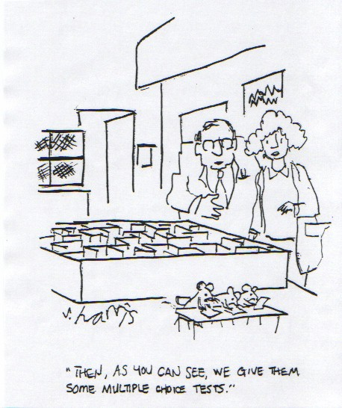

Slide 70
Premise
Classroom practices
Assessment practices
Faculty disciplinary discussions
Change

Slide 71
Backward Design
Identify desired goals/objectives
Determine acceptable evidence
Design learning experiences and instruction
Wiggins and McTighe 2005

Slide 72
Report Out
Tanner, K. 2010. Order Matters: Using the 5E model to align teaching with HPL
Guiding Question: What is the link of the 5E model to HPL?
Engage
Explore
Explain
Elaborate
Evaluate

Slide 73
Within Teams
Share ideas of possible topics for an introductory biology (cell/molecular, organismal/population), genetics, ecology, evolution course based on the papers you found for this week.
Write topics and paper on postits

Slide 74
5Es #2 Explore: Begin working with assessment

Slide 75
Exploring Assessment

Slide 76
How will you process student’s work?

Slide 77
The Power of Misconceptions
Lessons from Thin Air
Minds of Our Own
https://www.youtube.com/watch?v=NJwXYZ4GryA

Slide 78
Explain: What is the problem?
Identify students’ misconceptions.

Slide 79
What is assessment?
Data collected to inform instructor and student about learning
Quantitative and qualitative
Formative and summative

Slide 80
Attributes of Meaningful Assessment
Engages students in scientific practices
Relevant and aligned with learning goals
Elicits prior knowledge and misconceptions about core ideas
Teaches students to evaluate what they know (and what they don’t know)
Provides feedback about learning to instructor and students

Slide 81
Assessment Gradients
Multiple Choice, T/F, completion
Explanations, Quantitative responses
Models
Essay, Research papers/reports
Oral Interview
Low
Potential for assessing learning
High
High
Low
Ease of
Assessment
Ability to
engage in
Scientific
Practices
Low
High
Theoretical Framework
• Ausubel 1968; meaningful learning
• Novak 1998; visual representations
• King and Kitchner 1994; reflective judgment

Slide 82
Bloom’s Taxonomy: A Nested Hierarchy
Higher-level cognitive skills
Synthesis & Evaluation
Analysis
Knowledge
Application
Comprehension
From the MSU Liberal Learning Goals:
Analytical Thinking – e.g., acquires, analyzes, and evaluates information from multiple sources
Lower-level cognitive skills

Slide 83
Q. What ‘thinking’ are we asking students to do with their brain for this question?
The total amount of energy that plants assimilate by photosynthesis is called
gross primary production
net primary production
biomass
a pyramid of energy
succession
Notes:
For example, one may ask themselves what is actually being assessed here. This is an example of a question that would not provide feedback to instructors on the students knowledge and is focused on more trivial information.

Slide 84
Q. What ‘thinking’ are we asking students to do with their brain for this question?
Notes:
For example, one may ask themselves what is actually being assessed here. This is an example of a question that would not provide feedback to instructors on the students knowledge and is focused on more trivial information.

Slide 85
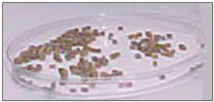
Radish Problem
Experimental setup:
Weighed out 3 batches of radish seeds
each weighing 1.5 g.
Experimental treatments:
Seeds placed on DRY paper towels in LIGHT
Seeds placed on WET paper towels in LIGHT
Seeds placed on WET paper towels in DARK
Seeds placed on DRY paper towels in DARK
in Ebert-May D, Batzli J, Lim H. 2003. Bioscience 53:1221-1228.

Slide 86
Radish Problem (cont)
After 1 week, all plant material was dried in an oven overnight (no water left) and plant biomass was measured in grams.
Predict the biomass of the plant material in the various treatments.
No Water, light
Water, light
Water, dark
No water, dark

Slide 87
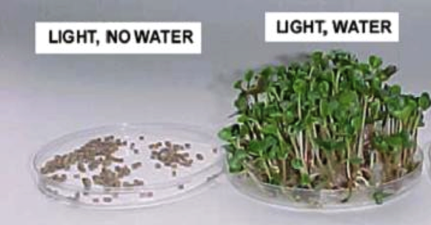
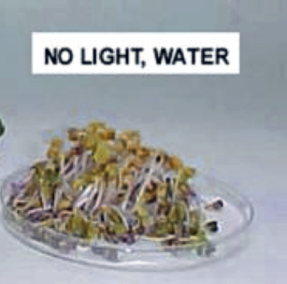
Results- Biomass of Radish
DARK, NO WATER
1.46 g 1.63 g 1.20 g
Qx. Explain why each treatment is different than 1.5g.
Think individually
Discuss the results with a partner
Report out in 2 minutes

Slide 88
Develop two learning objectives for the radish problem. Include a scientific practice. Students will be able to…..
In your group

Slide 89
Practice-based Biology
Models
build, use, revise
Explanations
Describe, reason, evaluate
Arguments
claim, evidence, warrants (reason)
Collaboration
Data
collect, represent, analyze
. . . MAD Bio!!
Long, T. 2015. PLB Michigan State University

Slide 90
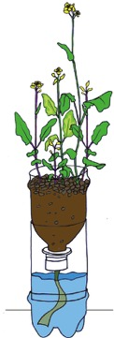
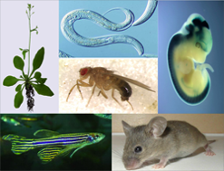
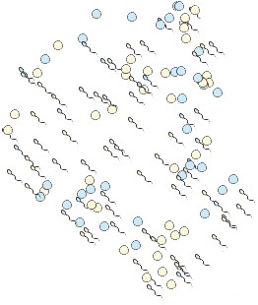
Generalized Life Cycle
Diploid (2N)
Diploid (2N)
Haploid (1N)
(sometimes)
Batzli and McGee, UW Madison, Biocore
Notes:
In a 2 allele system- with haploid and diploid phases to the life cycle!
Given all of the words…label boxes
Where is mitosis occurring? Meiosis? Fertilization?

Slide 91
In groups: How would you connect these concepts to make a model that explains how hay is related to the production of milk?
Hay
Cow
Milk
Notes:
Cow eats hay; cow produces milk

Slide 92
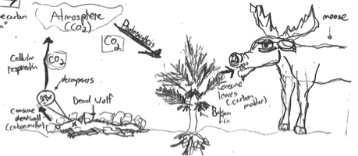
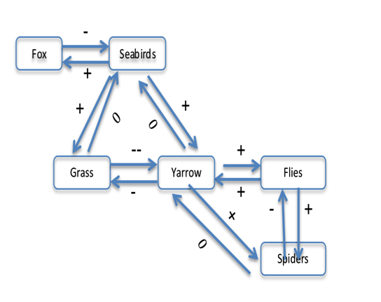
Models have...
1. Components (Structures)
Parts, objects → nouns
2. Relationships
- Usually mechanisms. Explain how structures interact → verbs
3. Function
- What the model does (what it explains or predicts)
Notes:
Explain what the +s and -s are; e.g., seabirds might increase the production of yarrow b/c of poop
Could change each of the positives or negatives to a word
Foxes prey on seabirds
Seabirds provide food for foxes

Slide 93
Model building checklist
Structures go in boxes (usually nouns).
Relationships go on arrows (usually verbs, short phrases that explain mechanisms and processes).
Arrows have direction; direction matters
Not all structures are necessarily linked to all others
- Linkages must be relevant and contribute toward explaining the model’s function
Should NOT read like a sentence, but
Propositions must stand alone
- structure –[relationship]→structure
Whole model “tells a story” (i.e., it communicates the function of the model)
Write a figure legend for each model that explains the function of the model.
Cow
Eats
Hay

Slide 94
Box and Arrow Model Construction
Structures – concepts, traits (what are the parts?)
Relationships – behaviors, processes (how to the parts connect?)
Function – purpose – collectively, what do the parts do?
Coiled into
Chromosomes
Coiled into
Locus is
Locus is
DNA
Coding section is
Coding section is
Gene
Figure 1. How cellular information is organized.
Derived from Goel et al. 1996
Notes:
According to Goel and others since, all models have 3 main components: S – R – F
With a framework in place, we set out to answer questions about models in the introductory biology course.

Slide 95
Writing figure legends: check list
Describe what is shown in the figure or table. Scientific descriptions are brief and clear.
Do NOT begin with “This figure shows…” Your reader already knows this.
Refer to the organism, molecule, or other component(s) in the data (e.g. bacteria, mangroves, fish).
A figure legend should stand alone. (e.g. Your reader should know what the table or figure is describing without reading anything else in the text of the paper or assignment.)

