Slide 1
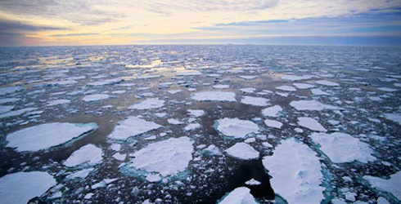
Climate change
Acknowledgments and thanks to Dr. Steve Running, from whom some parts of this were lecture drawn

Slide 2
The starting point: the global mean surface temperature has increased since humans began directly observing it with thermometers.

Slide 3
Causes
Most scientists accept that that the Earth has warmed up.
Is it due to greenhouse gases produced by humans building up in the atmosphere, or is it part of natural cycles of warming and cooling—and isn’t closely related to human activities?

Slide 4
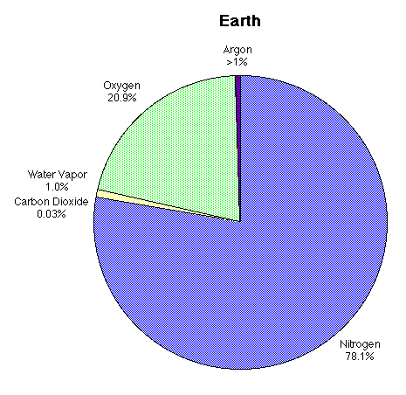
Observation #1
The greenhouse effect is real. It keeps the Earth’s surface warmer than it would otherwise be. The physics of this effect are well known—and depend on how several trace gases in the atmosphere interact with heat.

Slide 5
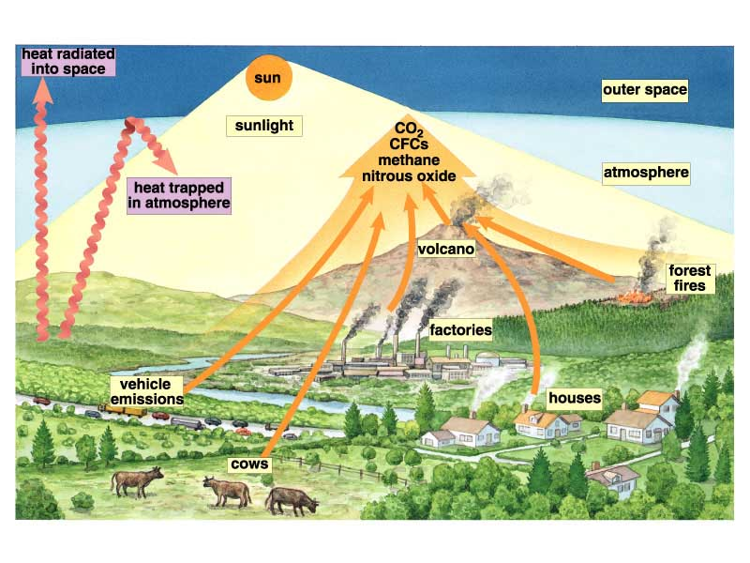
Observation #1, cont.
Some minor components of the atmosphere exert a disproportionate effect on how much heat the atmosphere retains.

Slide 6
Observation #2
Greenhouse gas concentrations have jumped since the start of the industrial revolution.

Slide 7
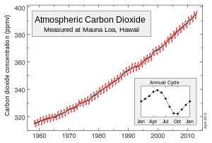
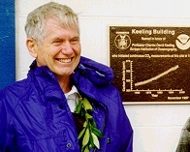
Observation #2
Charles Keeling was the first to take detailed measurements. He set up his instruments on top of Mauna Loa, as far from industrial sources of carbon dioxide as possible.

Slide 8
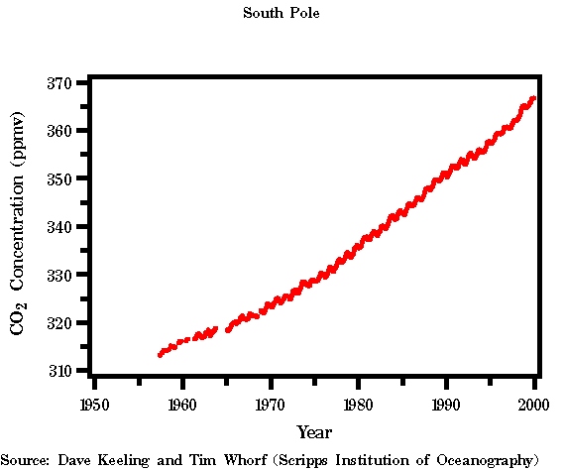
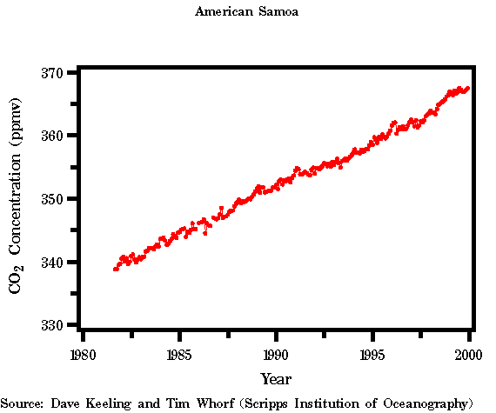
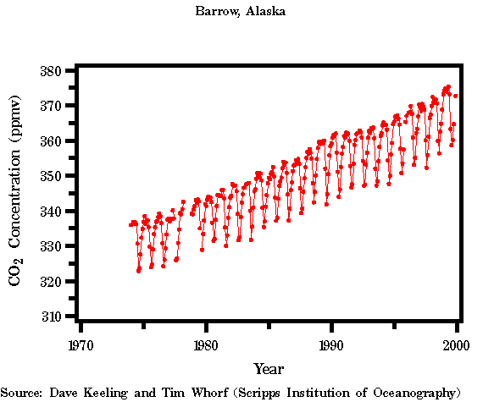
Observation #2
This increase is not restricted to the summit of Mauna Loa. It turns out that no matter where you look, carbon dioxide concentrations have gone up.

Slide 9
Observation #2
400
Indermühle et al. 1999 Ice core data from Antarctica extending back 11,000 years.
380
360
340
CO2 Conc. (ppm)
320
300
280
260
12000
10000
8000
6000
4000
2000
0
Time (years before present)

Slide 10
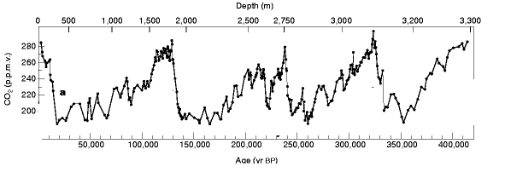
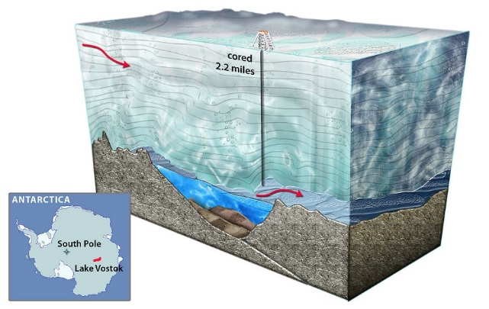
Observation #2
Here are ice core data from one of the deepest cores ever taken, through the ice above Lake Vostok on Antarctica. The carbon dioxide data reveal four major glacial periods, each about 100,000 years long.
Time

Slide 11
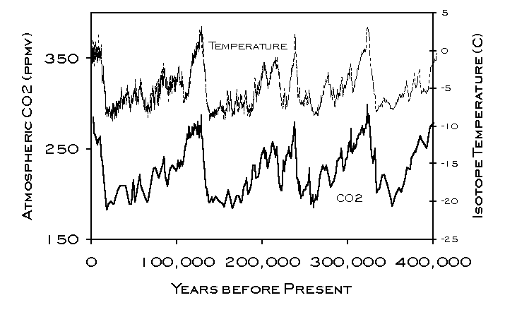
Observation #3
Historically, there has been a strong correlation between temperature and carbon dioxide. These data show the correlation over the last 400,000 years.
Time

Slide 12
Observation #4
Most of the increase in atmospheric carbon dioxide concentration is due to the combustion of fossil fuels.

Slide 13
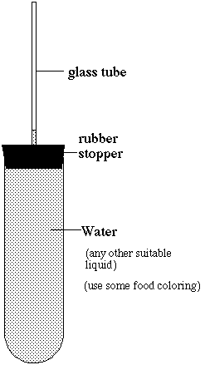
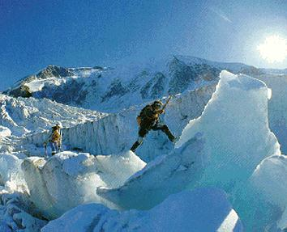
Other consequences besides higher temperatures….
Rising sea levels
This is occurring because
-glaciers and ice fields are melting
-higher sea temperatures is causing water to expand

Slide 14
Rising sea levels

Slide 15
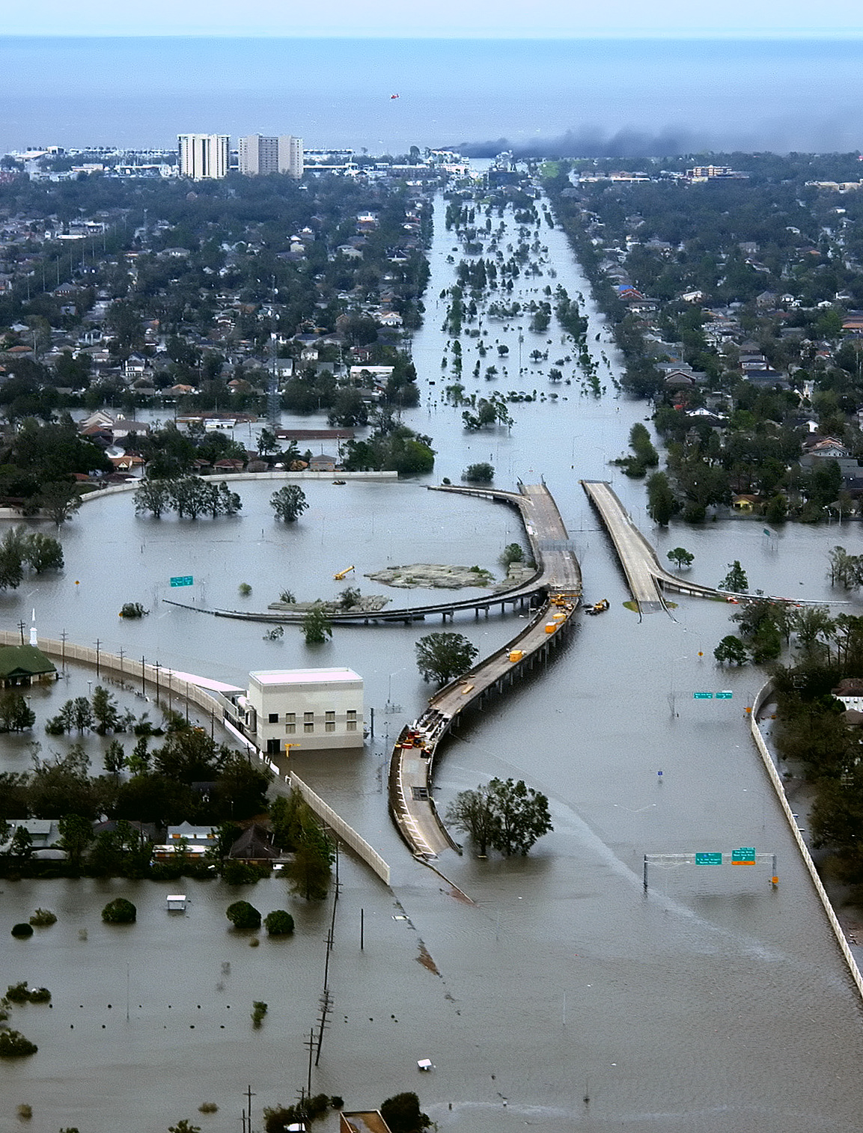
New Orleans after Hurricane Katrina, 2005

Slide 16
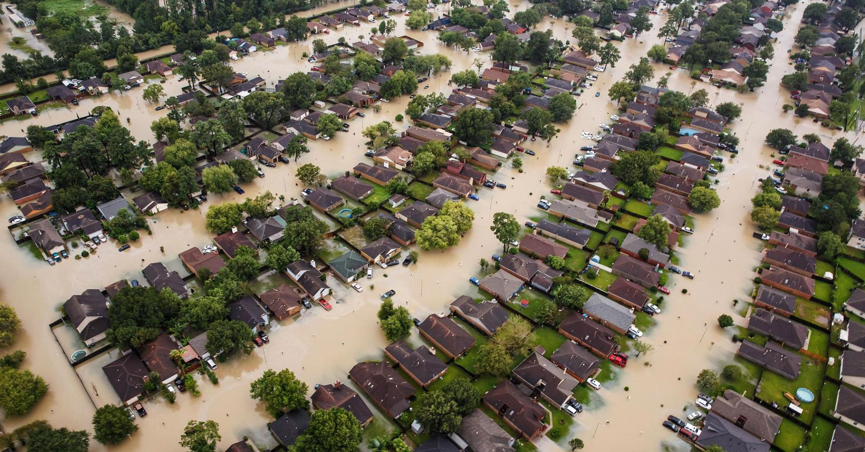
Houston after Hurricane Harvey, 2017

Slide 17
Retreating glaciers

Slide 18
Sperry Glacier
Glacier National Park, MT
1913
W. C. Alden photo, courtesy GNP Archives
2008
Lisa McKeon photo, USGS
In 1913, Sperry Glacier’s mass spanned across the entire basin and the glacier’s terminus was recorded at over 150 ft. tall. Contemporary images show how the glacier has receded and separated into fragments.
USGS Repeat Photography Project
http://nrmsc.usgs.gov/repeatphoto/

Slide 19
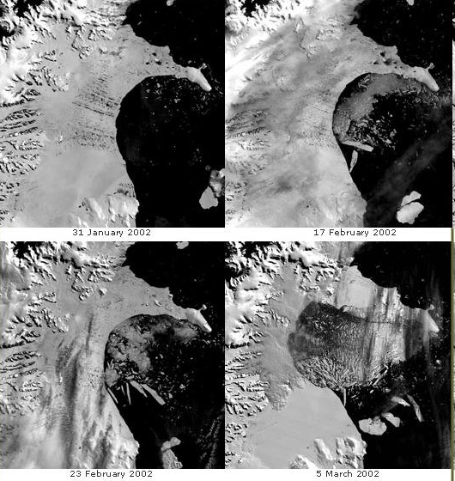
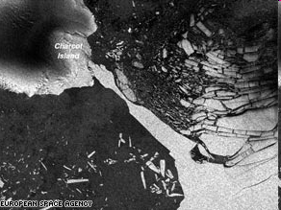
Retreating glaciers
Wilkins Ice Shelf in Antarctica fell apart about 4 years ago.
Collapse of Larsen B ice shelf in 2002

Slide 20
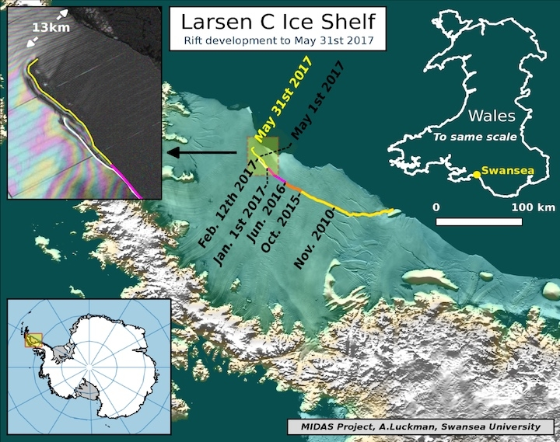
Larsen C ice shelf calves off world’s largest iceberg, July 2017. 1 trillion tons, 50,000 square km.

Slide 21
Retreating sea ice
NASA

Slide 22
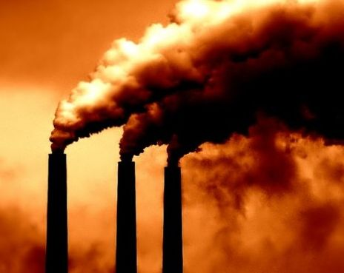
Ocean acidification
Over the last 200 years, about half of all CO₂ produced on earth has been absorbed by the oceans.
Atmosphere
Oceans
Half the CO₂ remains in the atmosphere
Half the CO₂ dissolves into the oceans, where it turns into acid.
CO₂ + H₂0 HCO₃⁻ + H⁺

Slide 23
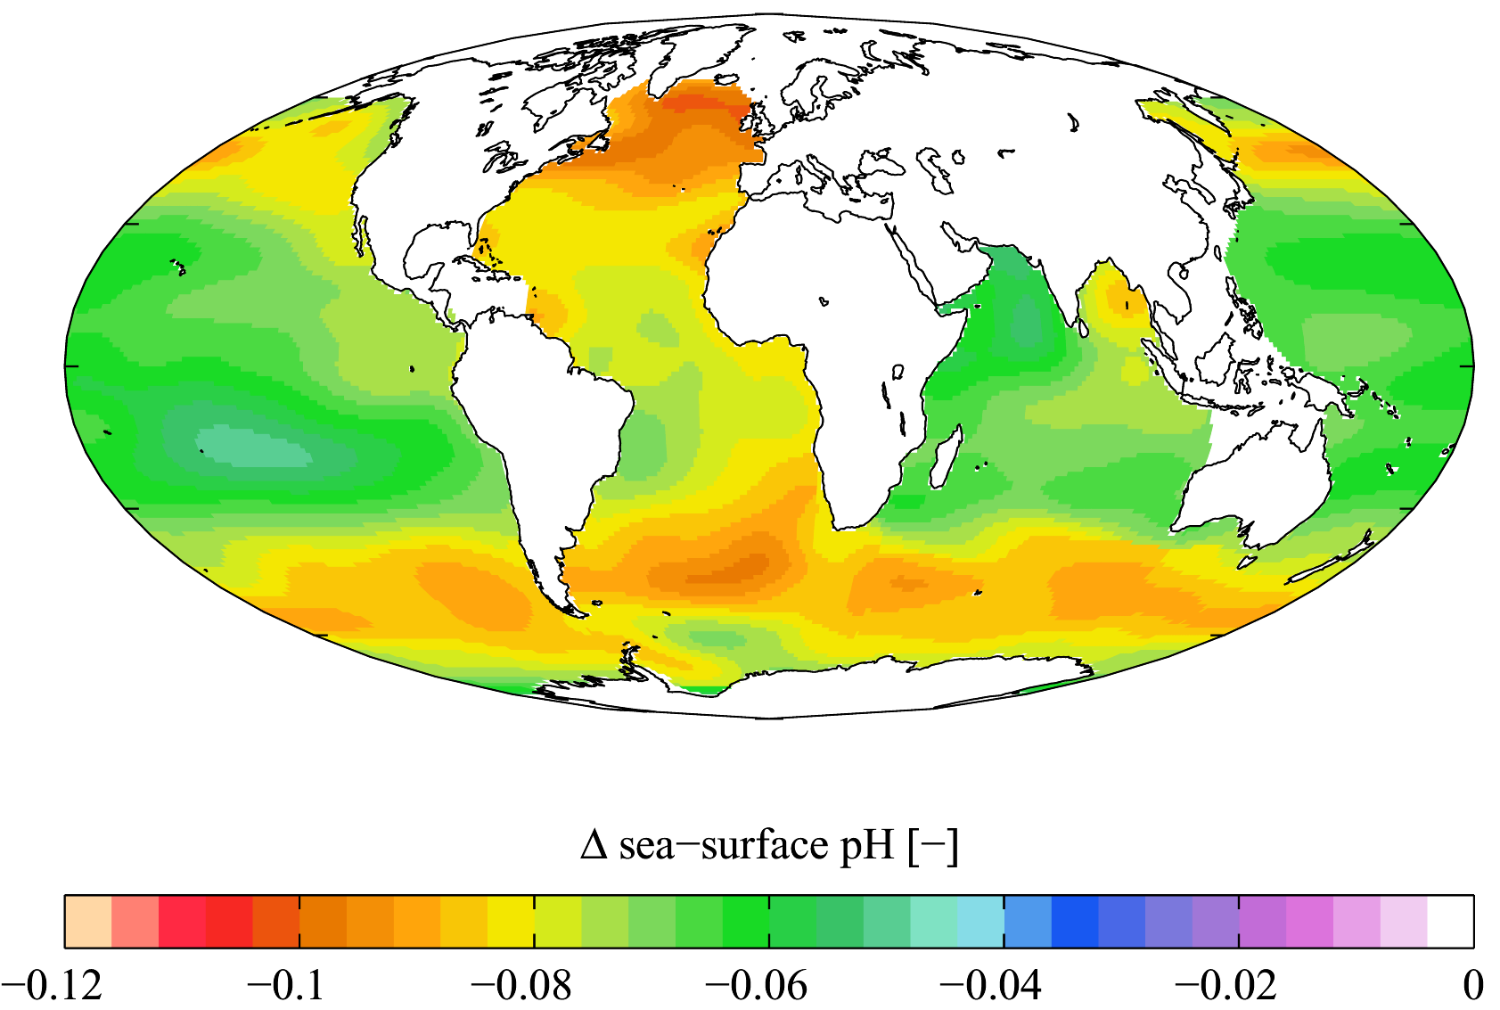
Ocean acidification
Estimated change in ocean pH between 1700 and 1990s

